Slide 1

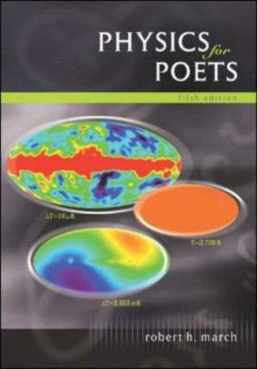
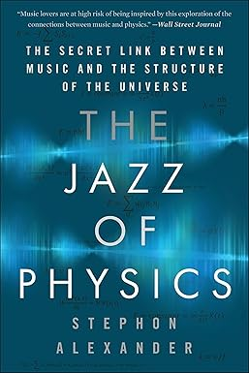
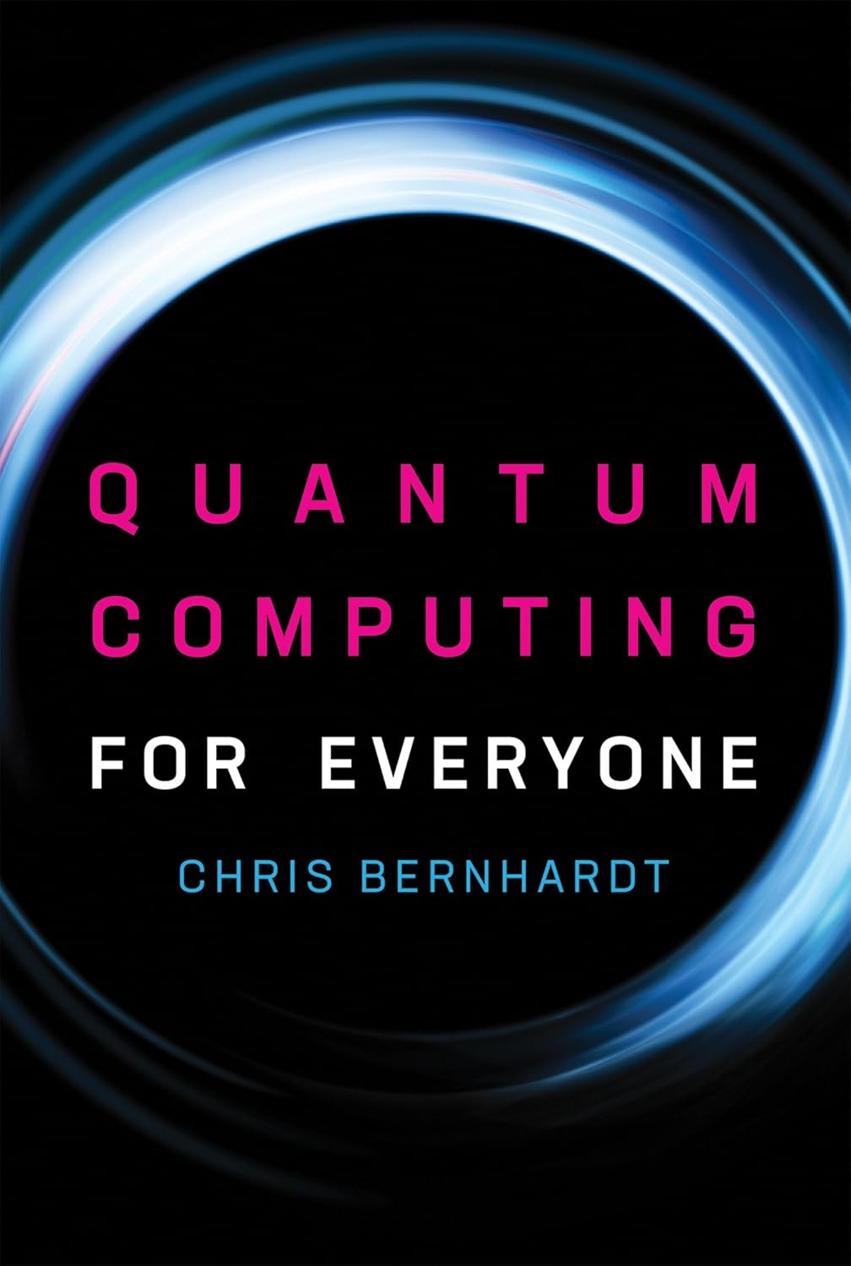
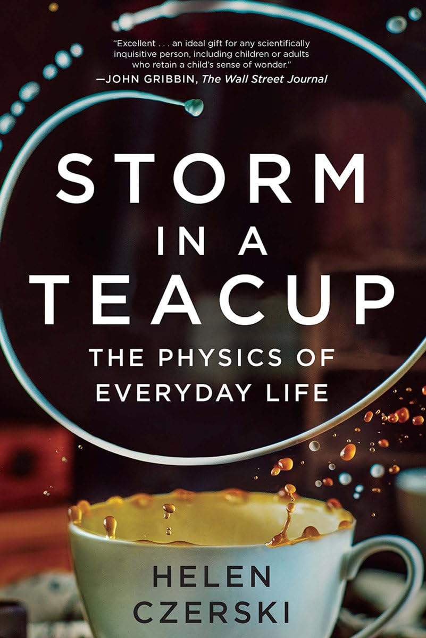
Less Math, More Wonder Physics Courses for Non-Scientists
Jason Harlow
Downtown Campus
University of Guelph Physics Colloquium
Tuesday, November 18th, 2025 2:30 PM MACN 415

Slide 2
Outline of today’s talk
Why do we teach physics to non-scientists? What are the goals?
History of physics “breadth” courses since the 1970s
Active teaching techniques and Assessing Students
University of Toronto Physics Breadth Courses

Slide 3
Outline of today’s talk
Why do we teach physics to non-scientists? What are the goals?
History of physics “breadth” courses since the 1970s
Active teaching techniques and Assessing Students
University of Toronto Physics Breadth Courses

Slide 4
What are physics breadth courses?
At many universities, students must specialize in one or two disciplines, and they must also take a small number of courses outside their areas of specialization.
So-called “breadth courses” serve to expose students to areas of knowledge and critical methods outside their primary area of study.
Physics breadth courses could:
increase students’ knowledge of physics concepts and ideas.
give students insight into how physicists think and approach problems.
cultivate a long-lasting appreciation of evidence-based methods of inquiry.

Slide 5

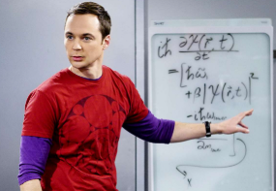
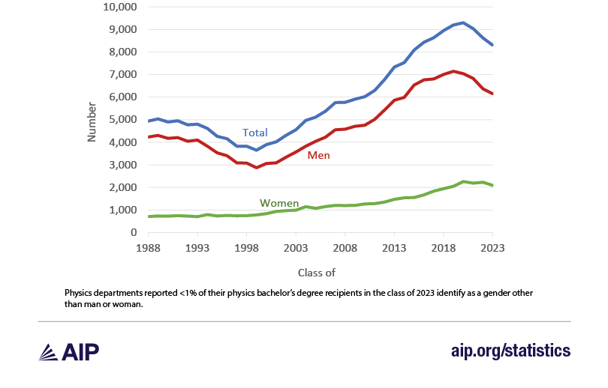
USA: Number of BS degrees in Physics per year peaked in 2020
In the 2023-24 academic year, U.S. institutions awarded 7,776 physics bachelor’s degrees, marking the fourth consecutive year of decline.
This downturn follows two decades of steady growth in the number of degrees conferred.
The 2023-24 total represents a 16% drop from the all-time high of 9,296 degrees awarded in 2019-20.
’07 – ‘19
https://www.aip.org/statistics/roster-of-physics-departments-with-enrollment-and-degree-data-2024

Slide 6

Popular breadth courses can significantly increase physics department enrolment
There are three large breadth courses offered at U of T downtown campus:
The Magic of Physics – fall 196 student enrolment cap, also offered in the summer to about 50 students
The Physics of Everyday Life – winter 196 student enrolment cap, also offered in the summer to about 50 students
The Physics of Music – winter - 330 student enrolment cap, online course with an in-person final exam.
Over 800 students per year!
Astronomy and Astrophysics more than doubles this: their cap for a “Contemporary Astronomy” equivalent is 2000 students per year!

Slide 7
Why should a non-science student study physics?
“You know you can’t enjoy a game unless you know its rules. Likewise, you can’t fully appreciate your surroundings until you understand the rules of nature. Physics is the study of these rules, which show how everything in nature is beautifully connected. I enjoy physics, and you will too – because you’ll understand it. If you get hooked and take a follow-up course, then you can focus on mathematical problems.” – Paul Hewitt, author of Conceptual Physics
“The complexity of today’s technology is built on straightforward physical principles that govern modern materials, scientific processes, and physical devices. Students use this technology daily, but many are unaware of how and why its systems and devices work.” – Niculescu et al 2000 Journal of Mathematics and Science

Slide 8
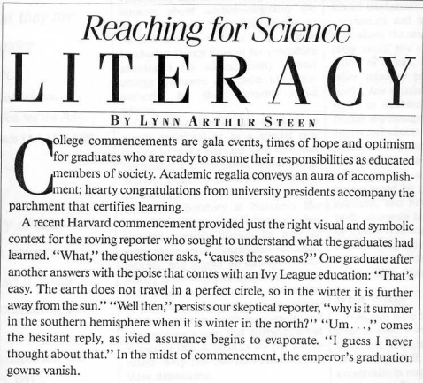
Why should a non-science student study physics?
“Every university in the country has the same dirty little secret: we are all turning out scientific illiterates, students incapable of understanding many of the important newspaper items published on the day of their graduation.” – Hazen and Trefil NYTimes Magazine 1991
http://www.steen-frost.org/Steen/Papers/91reaching-pub.pdf

Slide 9
Why should a non-science student study physics?
In the past few years, disbelief in science has been an issue of national news, especially during the COVID-19 pandemic, and the general public’s attitudes towards science are often filled with misconceptions, leading to polarization in beliefs and mistrust of scientists.
There are many inaccurate stereotypes of scientists that are pervasive in society as well, such as the “lone male white genius” trope.
How has science education failed to address these beliefs, and what can we do to make a positive impact on students’ attitudes towards science?
- Lewis et al 2022 Astronomy Education Journal https://arxiv.org/abs/2209.02852

Slide 10
Outline of today’s talk
Why do we teach physics to non-scientists? What are the goals?
History of physics “breadth” courses since the 1970s
Active teaching techniques and Assessing Students
University of Toronto Physics Breadth Courses

Slide 11
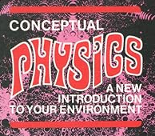
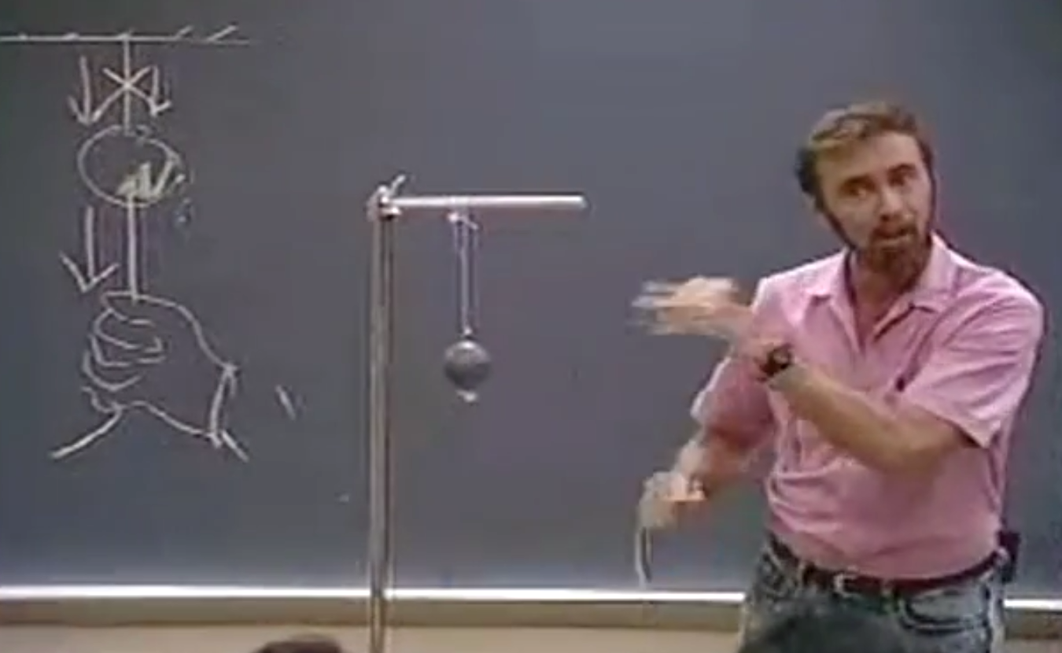
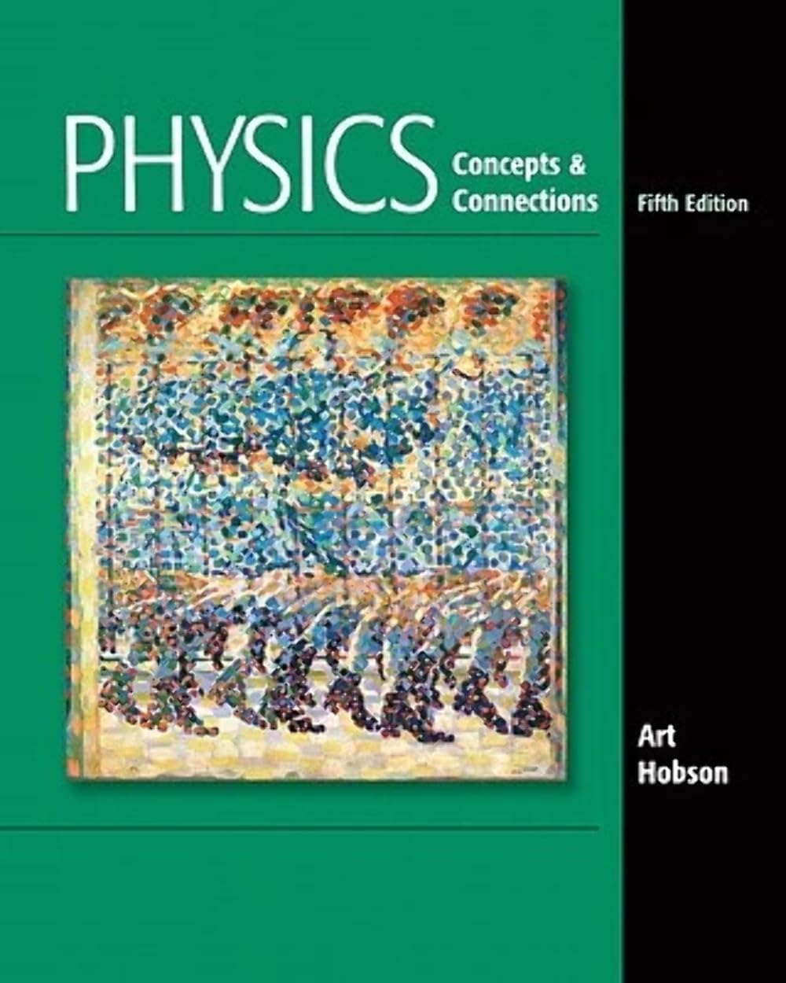
“Magic of Physics”: General First-Year Physics … without so much math
When I go to a new dentist and they ask me what I do, if I say “I teach physics”, they get angry and drill a little harder.
But I think it’s all the math they really hate!
“Conceptual Physics” 1971 by Paul Hewitt is one of the first textbooks to focus on the ideas and using logical reasoning, and strongly de-emphasized the mathematics.
In 1995 Art Hobson wrote “Physics Concepts & Connections” which had a stronger emphasis on Scientific Literacy and Modern Physics, and had a bit less of the classical curriculum coverage of Hewitt’s book.

Slide 12
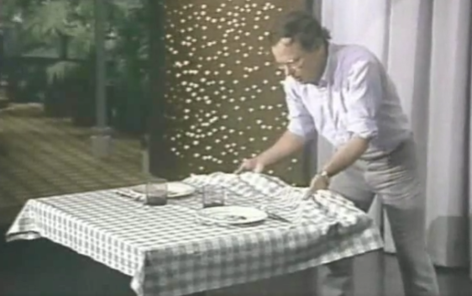
Demos, demos, demos!!!
Students love demonstrations, and certain professors love doing them.
Jearl Walker (pictured here) was a master physics demo guy and he wrote the book “Flying Circus of Physics”.
This teaching style choice lead to “Physics of Everyday Life” courses and “How things work”
The idea is you start with the observation or the technology, and then you explain the physics behind it.
How Things Work by Bloomfield
Table of Contents
Skating
Falling Balls
Ramps
Seesaws
Wheels
Bumper Cars
Spring Scales
Ball Sports: Bouncing
Carousels and Roller Coasters
Bicycles
Rockets and Space Travel
Balloons

Slide 13
Students want less math. But is that good?
Clearly “Fundamentals of Physics” for physics majors has too much original problem solving for a humanities student to really master.
Hewitt argues: “to the nonscience student, physics is enormously interesting, but paired with problem solving, the price of admission is too high for too many.”
Sobel (2009) responds with two objections:
Physics is inherently mathematical. Without some math and numbers, we lose the storyline and important connections.
Every university student must have studied math for around 11 years as a child. Why can’t they do some math?
One reason physics is so difficult is that we go too fast.
An obvious solution is to pick a sub-topic, and focus on less material, but go deeper.

Slide 14
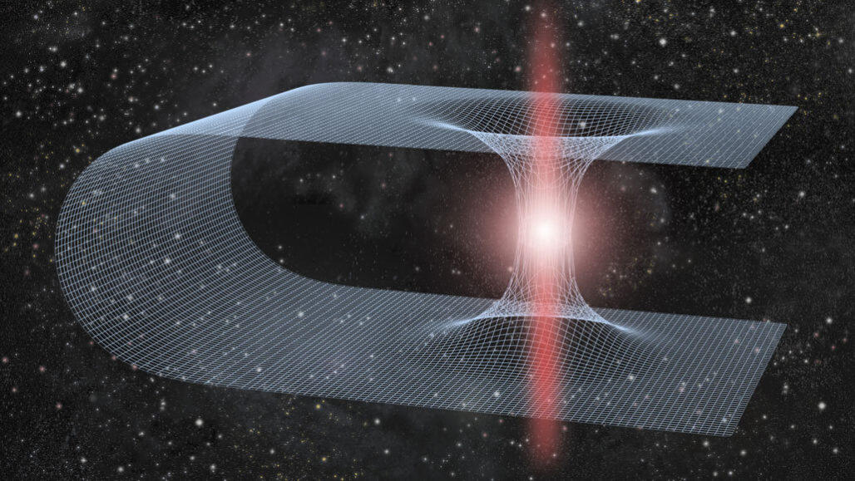
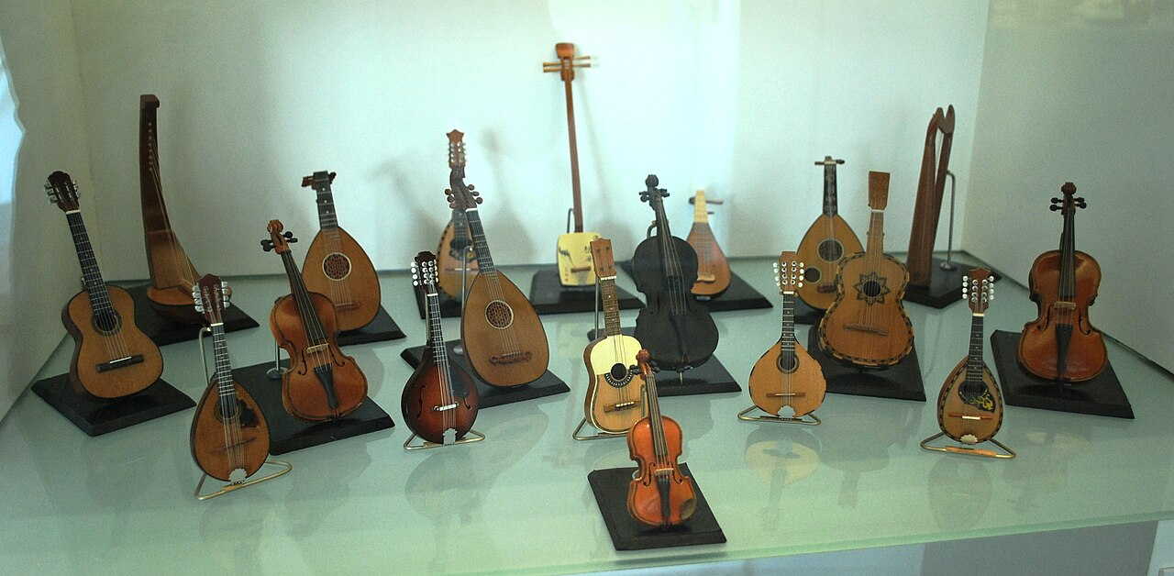
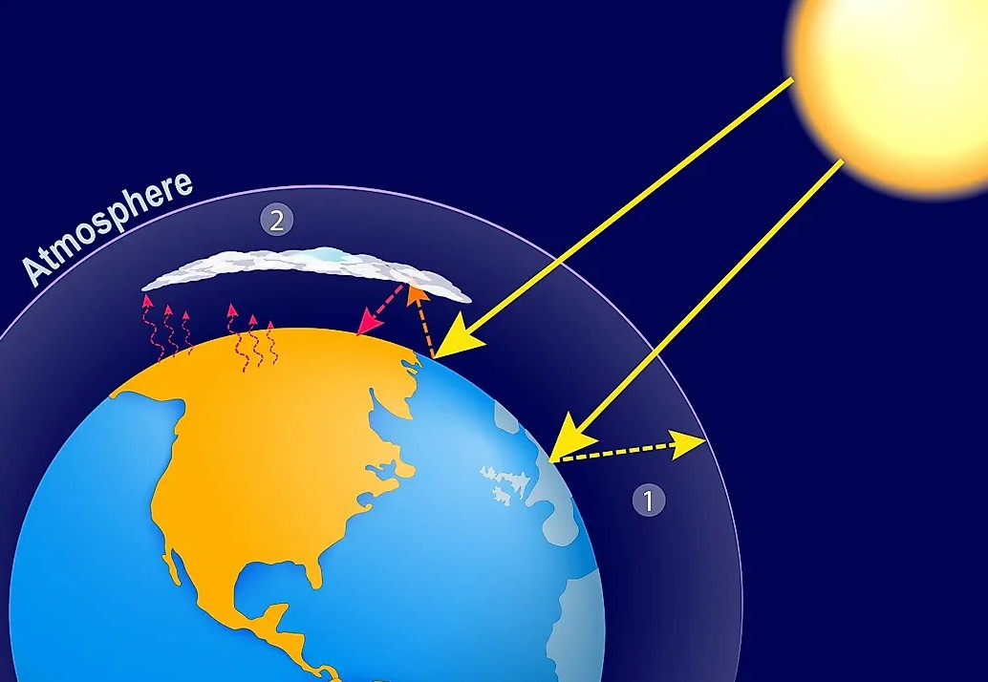
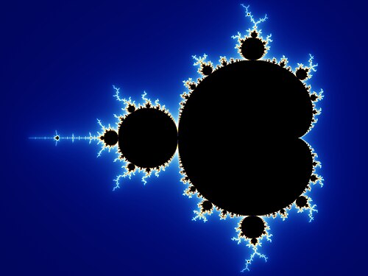
Special Topics: “Physics of…”
Modern Physics -
Black Holes and Schrodinger’s Cat
Here you draw in the student with a specific topic they already think is interesting, and then teach physics around it.
Almost every university has a popular Intro to Astronomy course that does this beautifully.
Music
Environment, Energy and Climate Change
Complexity, Chaos

Slide 15
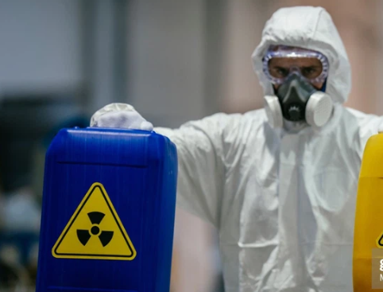

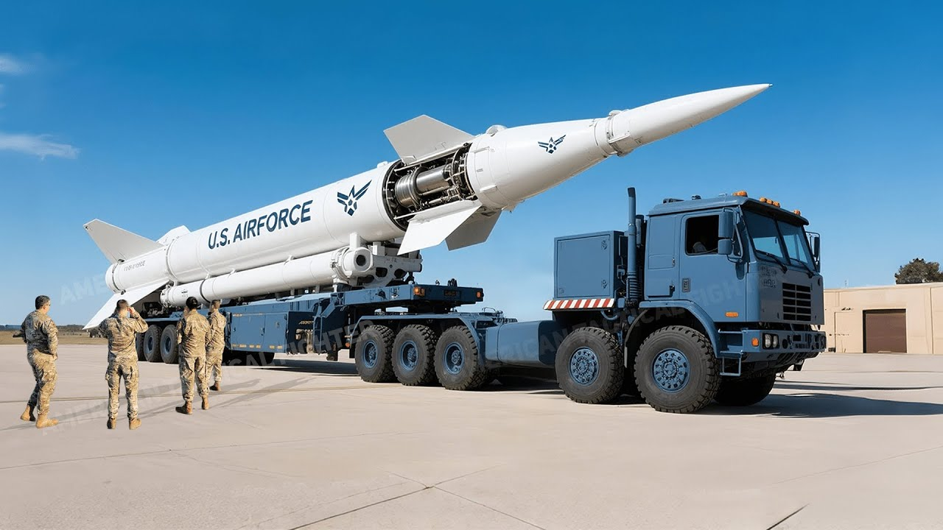
Special Audience: “Physics for…”
Physics for Future Presidents is a book by Richard A. Muller. It’s physics topics he thinks the president of the USA should know. There are five parts:
Terrorism (ie 9-11)
Energy (oil vs. solar)
Nukes (weapons, also risks of nuclear energy)
Space (Satellites, the Moon)
Global Warming
This was published in 2008 when Obama was running for president. These were hopeful times… Muller said in an interview that Michelle Obama had a copy of his book and she promised to give it to Barack.

Slide 16
Michael Sobel 2009 – Physics for the Non-Scientist: A Middle Way
Question: How can we design assessments to avoid the shallowness of memorization yet lie within the capability of the average student?
A Middle Way
Sobel proposes: “that we design a course that does what most other college courses do, a course that asks students to learn what the teacher does in class, and what the teacher assigns in the text, but nothing more.
It will be a course that does not demand ingenuity, that does not demand that the student put together two ideas that they have previously used separately, that does not demand that the student be clever.
The student sees a certain problem done in class, then tries three or four examples of the same problem with different numbers at home, and later has to do one on the exam.
For a given subject or chapter, there might be four or five such problems, starting with a simple plug-in followed by more complicated examples.”

Slide 17
Outline of today’s talk
Why do we teach physics to non-scientists? What are the goals?
History of physics “breadth” courses since the 1970s
Active teaching techniques and Assessing Students
University of Toronto Physics Breadth Courses

Slide 18

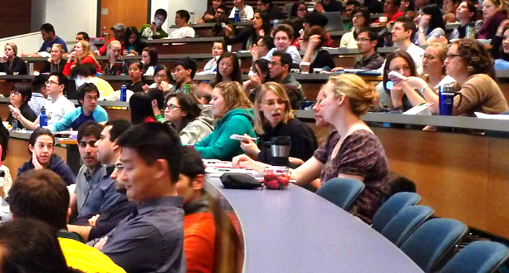
Active Learning
The main result of Physics Education Research is that what students learn depends on what the students do, not what the teacher does.
Hake (1998) published a nice meta-study of FCI results and found the best gains were always in courses that had what he called “Interactive Engagement”:
“designed at least in part to promote conceptual understanding through interactive engagement of students in heads-on (always) and hands-on (usually) activities which yield immediate feedback through discussion with peers and/or instructors”
It’s important, especially in large classes, to get students talking to each other about physics.

Slide 19


Student Response Systems
i-Clicker Remotes. I used these from 2006-2016. I miss those days…
Device-based apps or browser-based quiz systems:
Your LMS probably has a quiz function of some kind.
Top Hat
Poll Everywhere
The problem I have with all of these systems is that I am sending my students to their phone or device in the middle of class.
This creates a big distraction (as they check their notifications etc), and also creates a less social atmosphere – you are less likely to speak to your neighbour if your neighbour is looking at their phone – it’s rude.

Slide 20
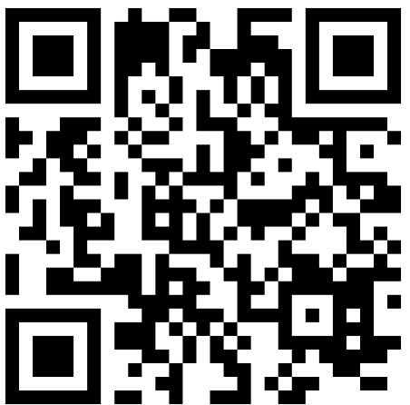
Old-style paper daily mini-quizzes
Each quiz question takes 2 to 5 minutes and is designed to get discussion going.
Blank paper works for small classes, if you have lots of students you can use a blank form and scan into crowdmark or gradescope or something.
I provide a big box of pencils, blank forms, and foldable voting cards, all of which I distribute at the start of each class.
During class I present the questions via Powerpoint, and try to get discussion going. Students can fill out their “first guess” and “consensus view”.
At the end of each class I collect the filled-out forms, scan them into a system called https://www.gradescope.ca/ and award participation + accuracy points.
See an 14-minute YouTube Video explaining the details of exactly how I do this in a class of 100 students here: https://youtu.be/Yh-J9OdSnxc

Slide 21
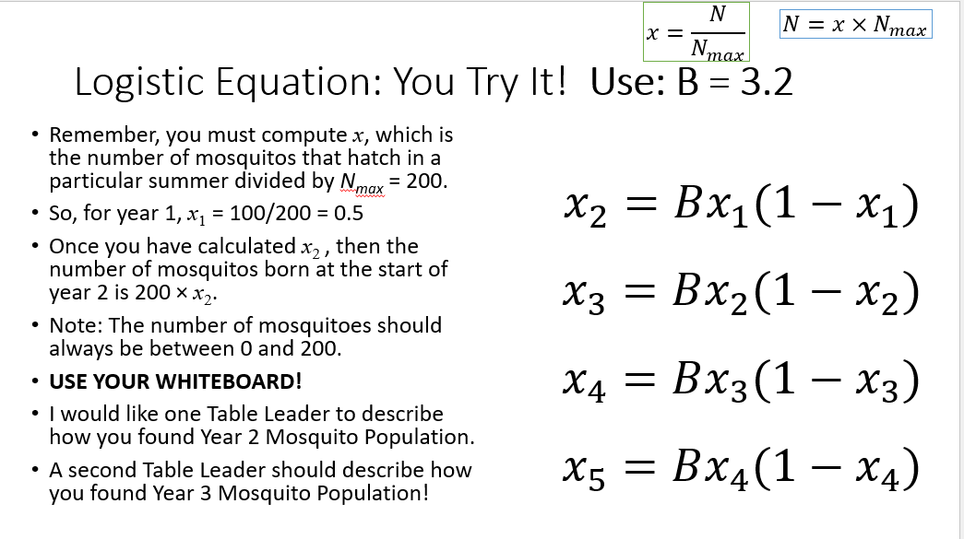
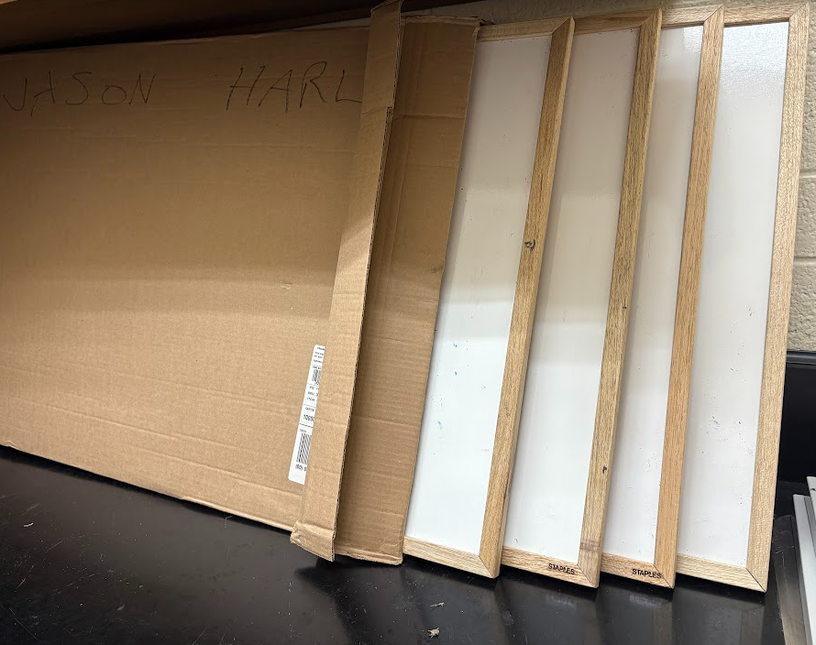
Whiteboard activities
In a class capped at 30 students I got a room with tables and distributed portable whiteboards.
In-class activities involved some drawing and brainstorming on the whiteboard.
“Vertical Learning”

Slide 22
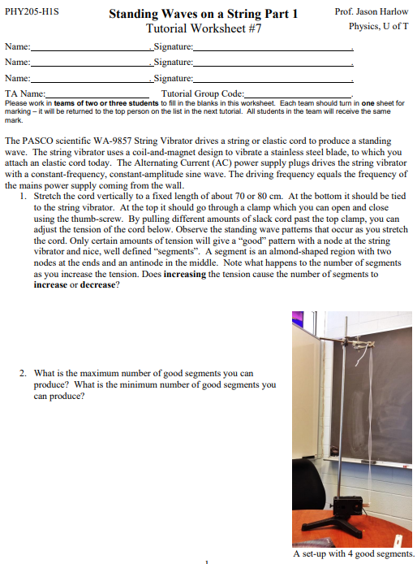
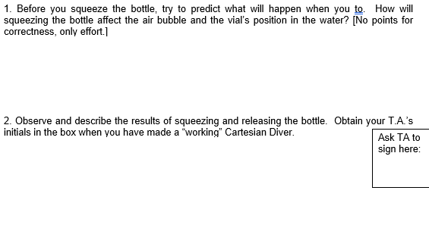
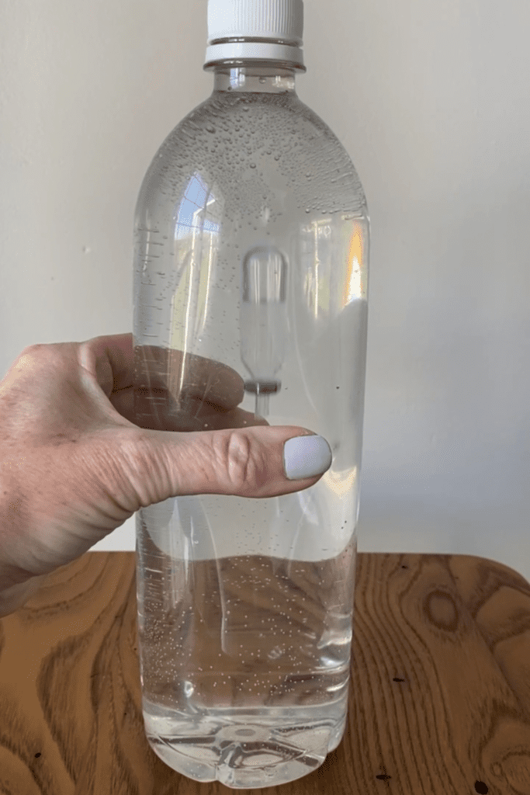
Hands-on Activities

Slide 23
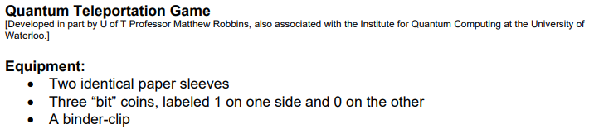
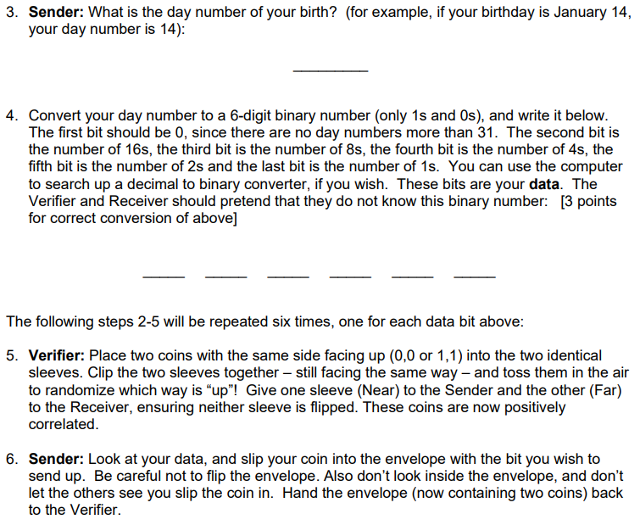
Parlour Games
Quantum cryptography

Slide 24
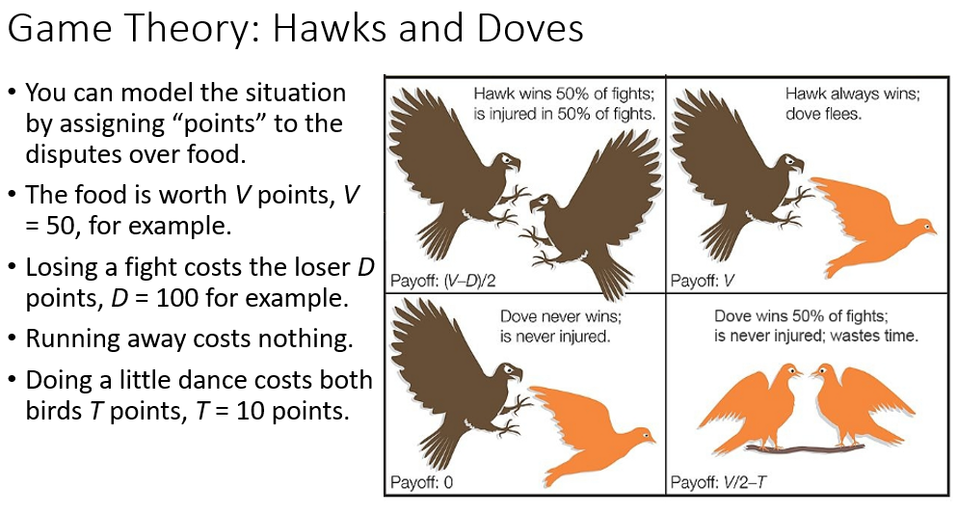
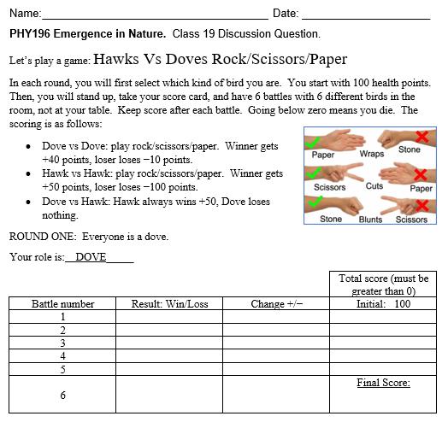
Parlour Games
Hawks Vs Doves game in Complexity course

Slide 25
Does all of this work?
Physics education researchers have created several surveys to measure students’ beliefs about physics, and science in general.
Colorado Learning Attitudes About Science Survey (CLASS) asks students to respond to 42 statements on a five point scale from A:‘strongly disagree’ to E:‘strongly agree’.
When physicists answer, 36 of the statements elicit strong consensus.
Student responses to these 36 statements can be scored to quantify how expert-like or novice-like their attitudes are.
Such surveys are usually given as a pre- and post-test to measure the “gain” or change in students’ beliefs over the course of a semester.
More recently, Watson et al (2025) at the University of Alberta have developed the Augustana Interdisciplinary Scientific Literacy Evaluation (AISLE) which tests not only attitudes but ability to reason scientifically.

Slide 26
Examples of CLASS statements
A significant problem in learning physics is being able to memorize all the information I need to know.
To understand physics I discuss it with friends and other students.
It is important for the government to approve new scientific ideas before they can be widely accepted.
Experts tend to agree with 2, and disagree with 1 and 3.

Slide 27
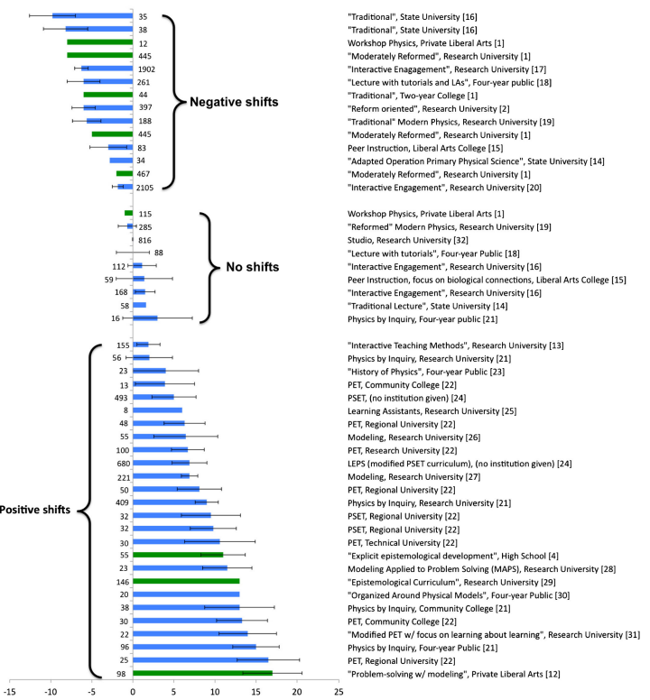
Does all of this work?
Madsen et al (2015) synthesized the results of 24 studies using CLASS.
Many traditional physics courses cause students to have negative shifts in attitudes.
Strongest gains come when labs, and peer instruction, and modeling instruction were included.
Also, smaller class size helps.

Slide 28
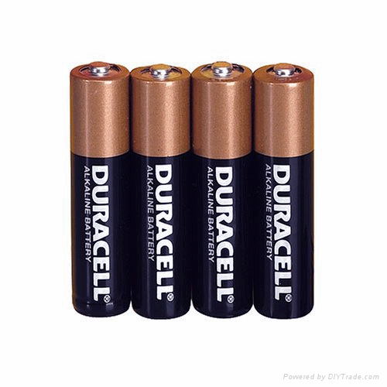
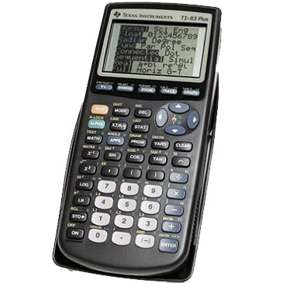
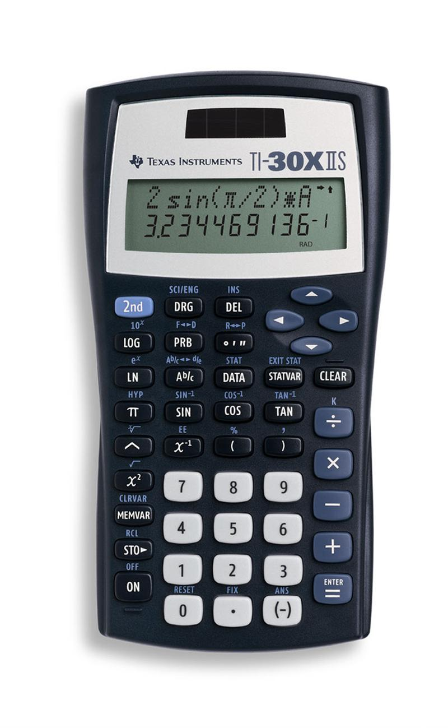
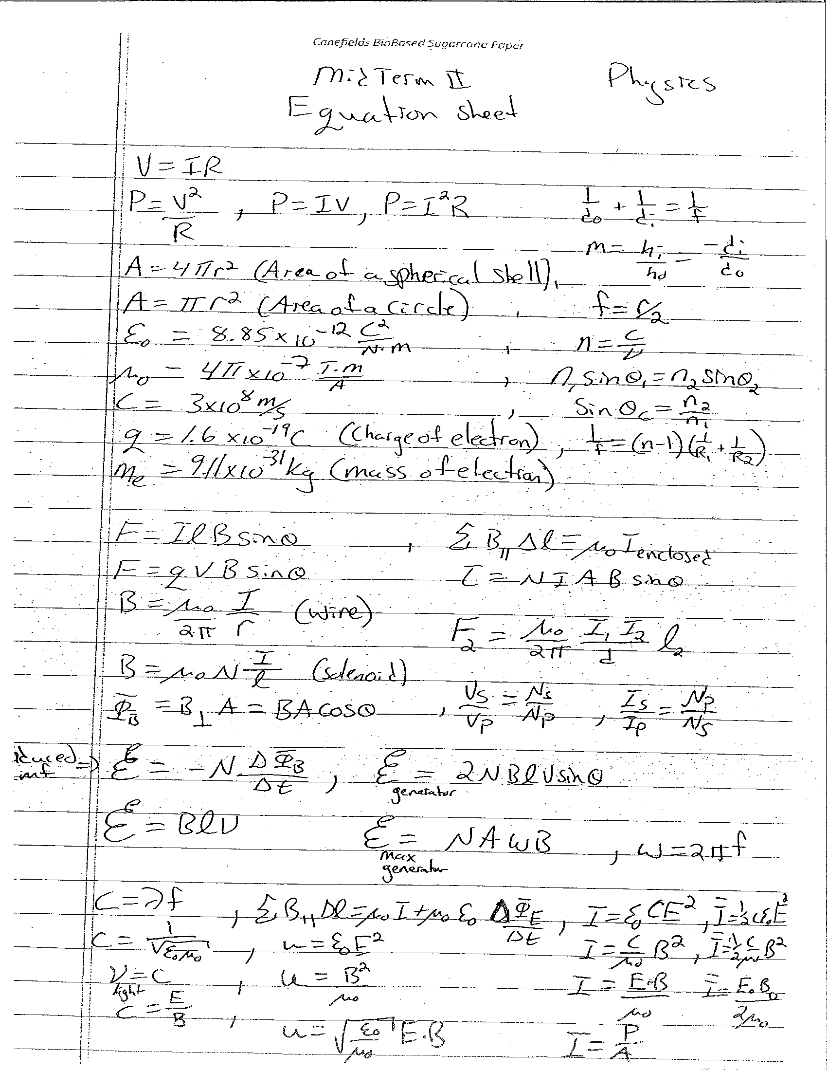
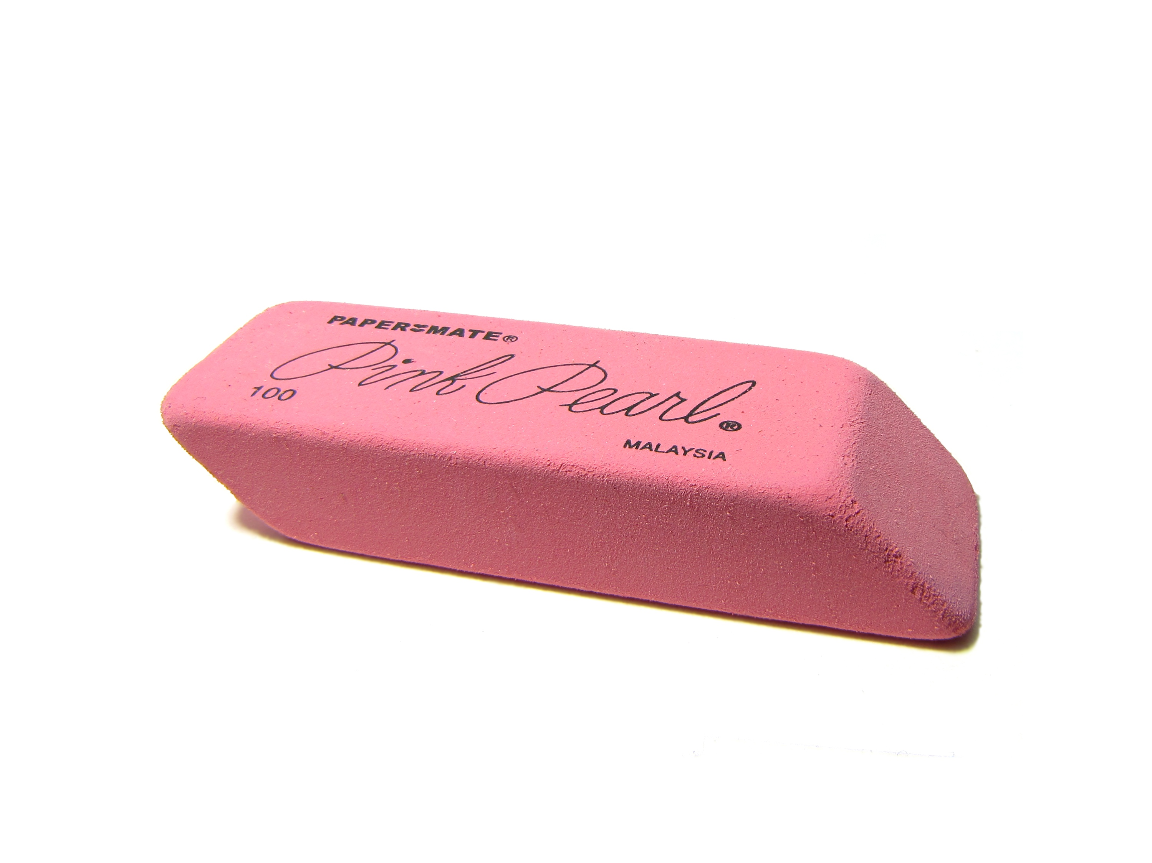

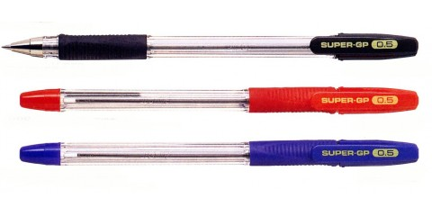


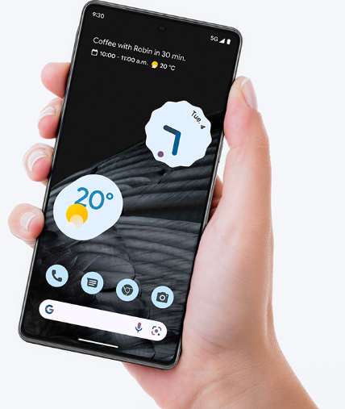
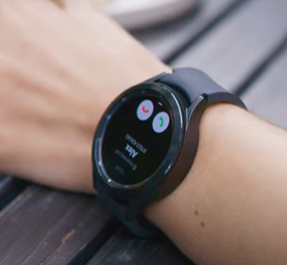
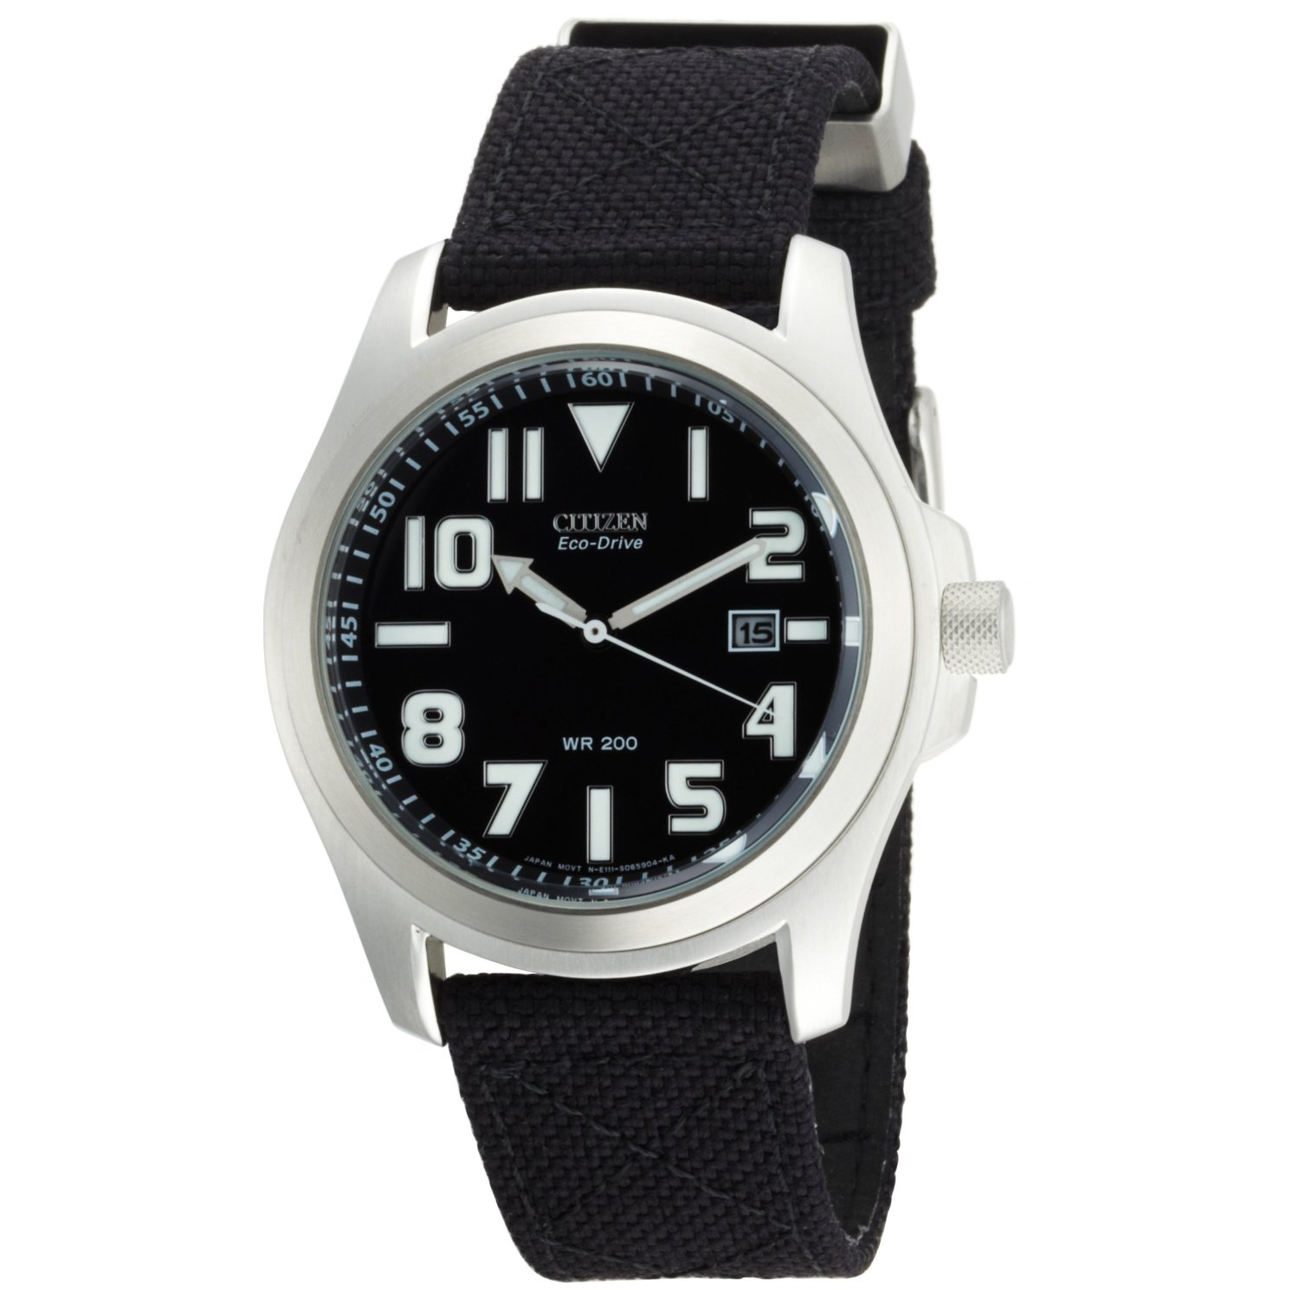
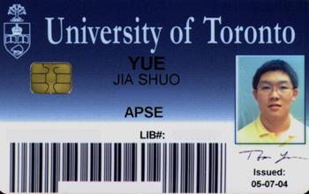
In-person testing
Old-fashioned in-person testing is vital for individual accountability – no devices except for a calculator, perhaps.
It’s good if the midterms and final exam total to 75% of the course mark.
The other 25% is “unsupervised” in the sense that they have access to their devices.

Slide 29
Writing Assignments
Research papers in the age of Generative AI are problematic.
If you tell students not to use GenAI, some won’t, and these honest students will be at a disadvantage.
I do not believe it is possible to catch and prosecute a student for using GenAI. You can never prove it, as it is “original”. Services like Turnitin.com do not work.
It is depressing to pay a Teaching Assistant for 30 minutes to read and mark an essay that was “written” in 15 seconds using one ChatGPT prompt.

Slide 30
Writing Assignments: Suggestions
Have them build something real, make a video showing it – I have each student create their own musical instrument using things around the house. Then they write about that video.
Have them write about a hands-on activity or experiment, as opposed to web-based research.
Some instructors explicitly allow use of AI to generate a first draft. Ie: “Use ChatGPT (or another AI) to generate a draft explanation of [physics concept]. Then revise the draft by (a) correcting errors, (b) adding real‐life applications, (c) providing your own reflective commentary.”
Some instructors interview each student about their paper – 15 minute “oral exams” to discuss their paper.

Slide 31
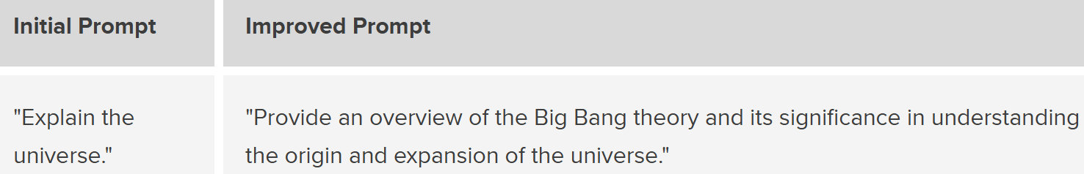
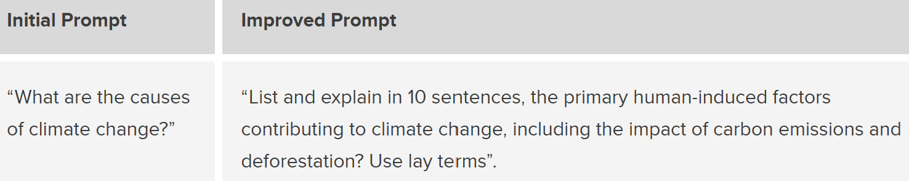
Writing Assignments
University of Calgary has a web-site called “Maximizing Learning with Effective GenAI Prompt Writing”.
The idea is to actually teach them how to write using AI – for example, instruction on the practice of writing prompts.
According to Oppenlaender et al. (2023), “prompt engineering is iterative and interactive — a dialogue between humans and AI in an act of co-creation.”

Slide 32
Outline of today’s talk
Why do we teach physics to non-scientists? What are the goals?
History of physics “breadth” courses since the 1970s
Active teaching techniques and Assessing Students
University of Toronto Physics Breadth Courses

Slide 33
Big Breadth courses at U of T Physics
There are three unlimited-enrolment breadth courses offered at U of T downtown campus, each of which draws about 300 students per year:
PHY100 – The Magic of Physics – survey of classical + modern physics, 250 students per year
PHY205 – The Physics of Everyday Life – Conceptual course using everyday objects (cars, weather, appliances, etc.) to teach underlying physics, 250 students per year
PHY207 – The Physics of Music –oscillations, waves, hearing, musical scales, instruments, digital audio, 330 students per year.
We use the “200” numbers, even though these are open to first years and have no prerequisites, because U of T limits the number of 100-series courses that can contribute to graduation requirements.

Slide 34
Small Breadth courses at U of T Physics
Faculty of Arts and Science requires every department to offer three “seminar-style” first-year courses which must limit to 25 students. We offer:
PHY196 – Emergence in Nature – chaos in nonlinear systems, spontaneous pattern formation
PHY197 – Modern Physics for the Curious – relativity, quantum physics, unification forces, string theory, and big bang cosmology
PHY199 – Dark Matter and Dark Energy are the New Black – the hypotheses of dark matter and dark energy, and the debates about what might really be going on.
We also teach ENV238 Physics of the Changing Environment to about 40 students per year, as part of the School of the Environment.

Slide 35
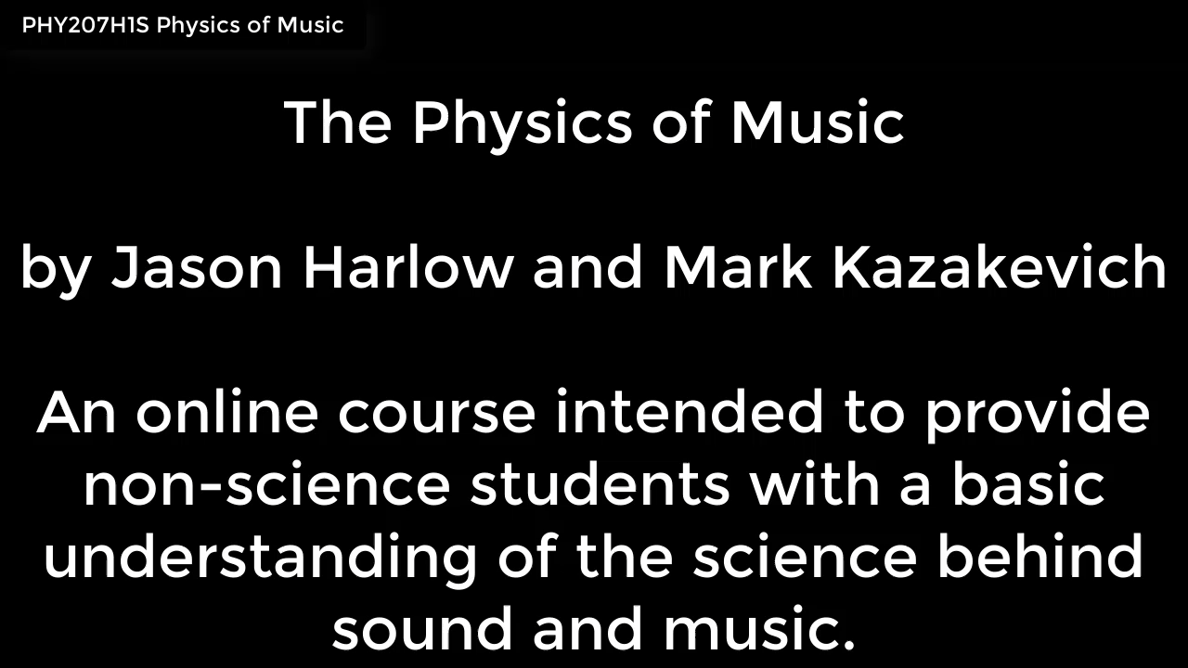
The Physics of Music
This was the first online course taught in physics at U of T. I started developing it in 2016 and first taught it in 2018.
I couldn’t find a good textbook that incorporated “A Middle Way” of math and doing practice, while not going too deep.
So I wrote a textbook; it is not yet published but it is my original content (with a coauthor), and is offered mainly in an online interactive format.
12 chapters, each with full colour figures and animations, interactive examples, end-of-chapter questions with complete solutions and problems with no solutions provided (Instructors Guides available). There are over 70 “lecture videos” also provided.
It will also soon be available as a big black and white PDF – about 350 pages. I’ve printed out the first 5 chapters if you’re interested.

Slide 36
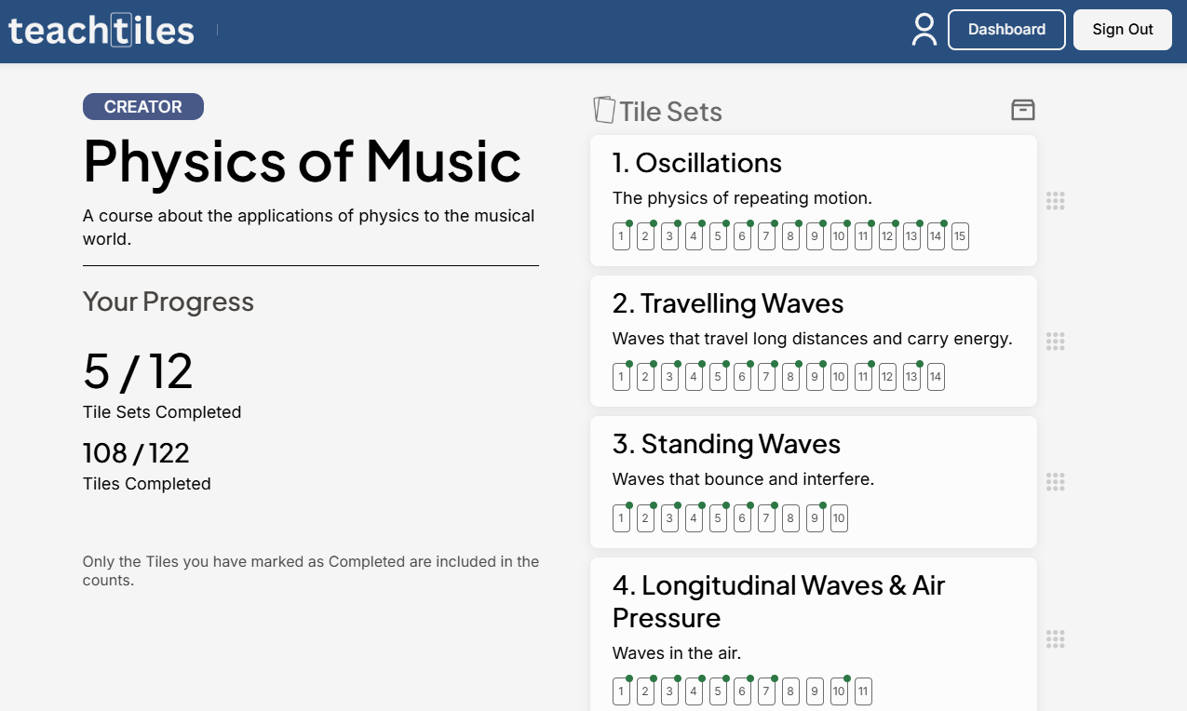
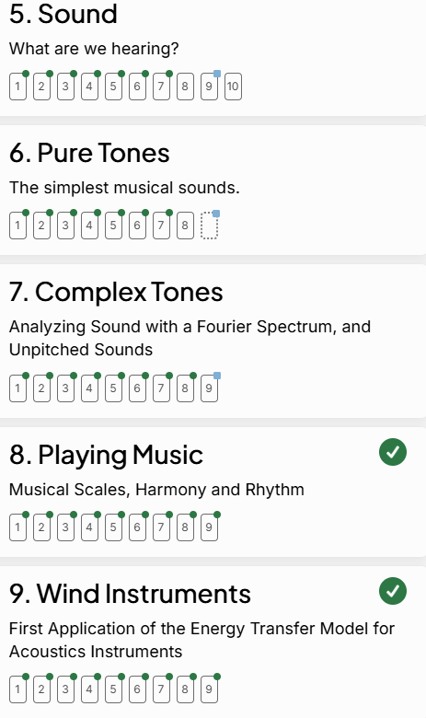
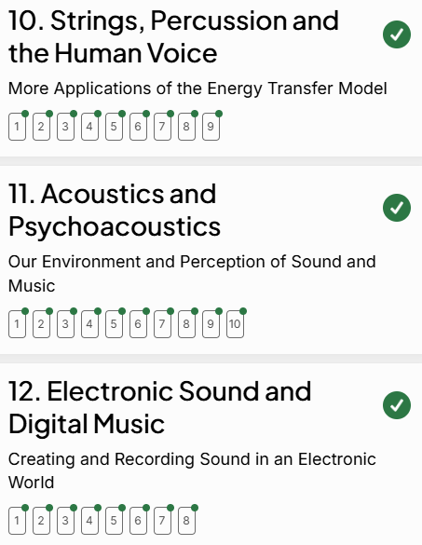

Slide 37
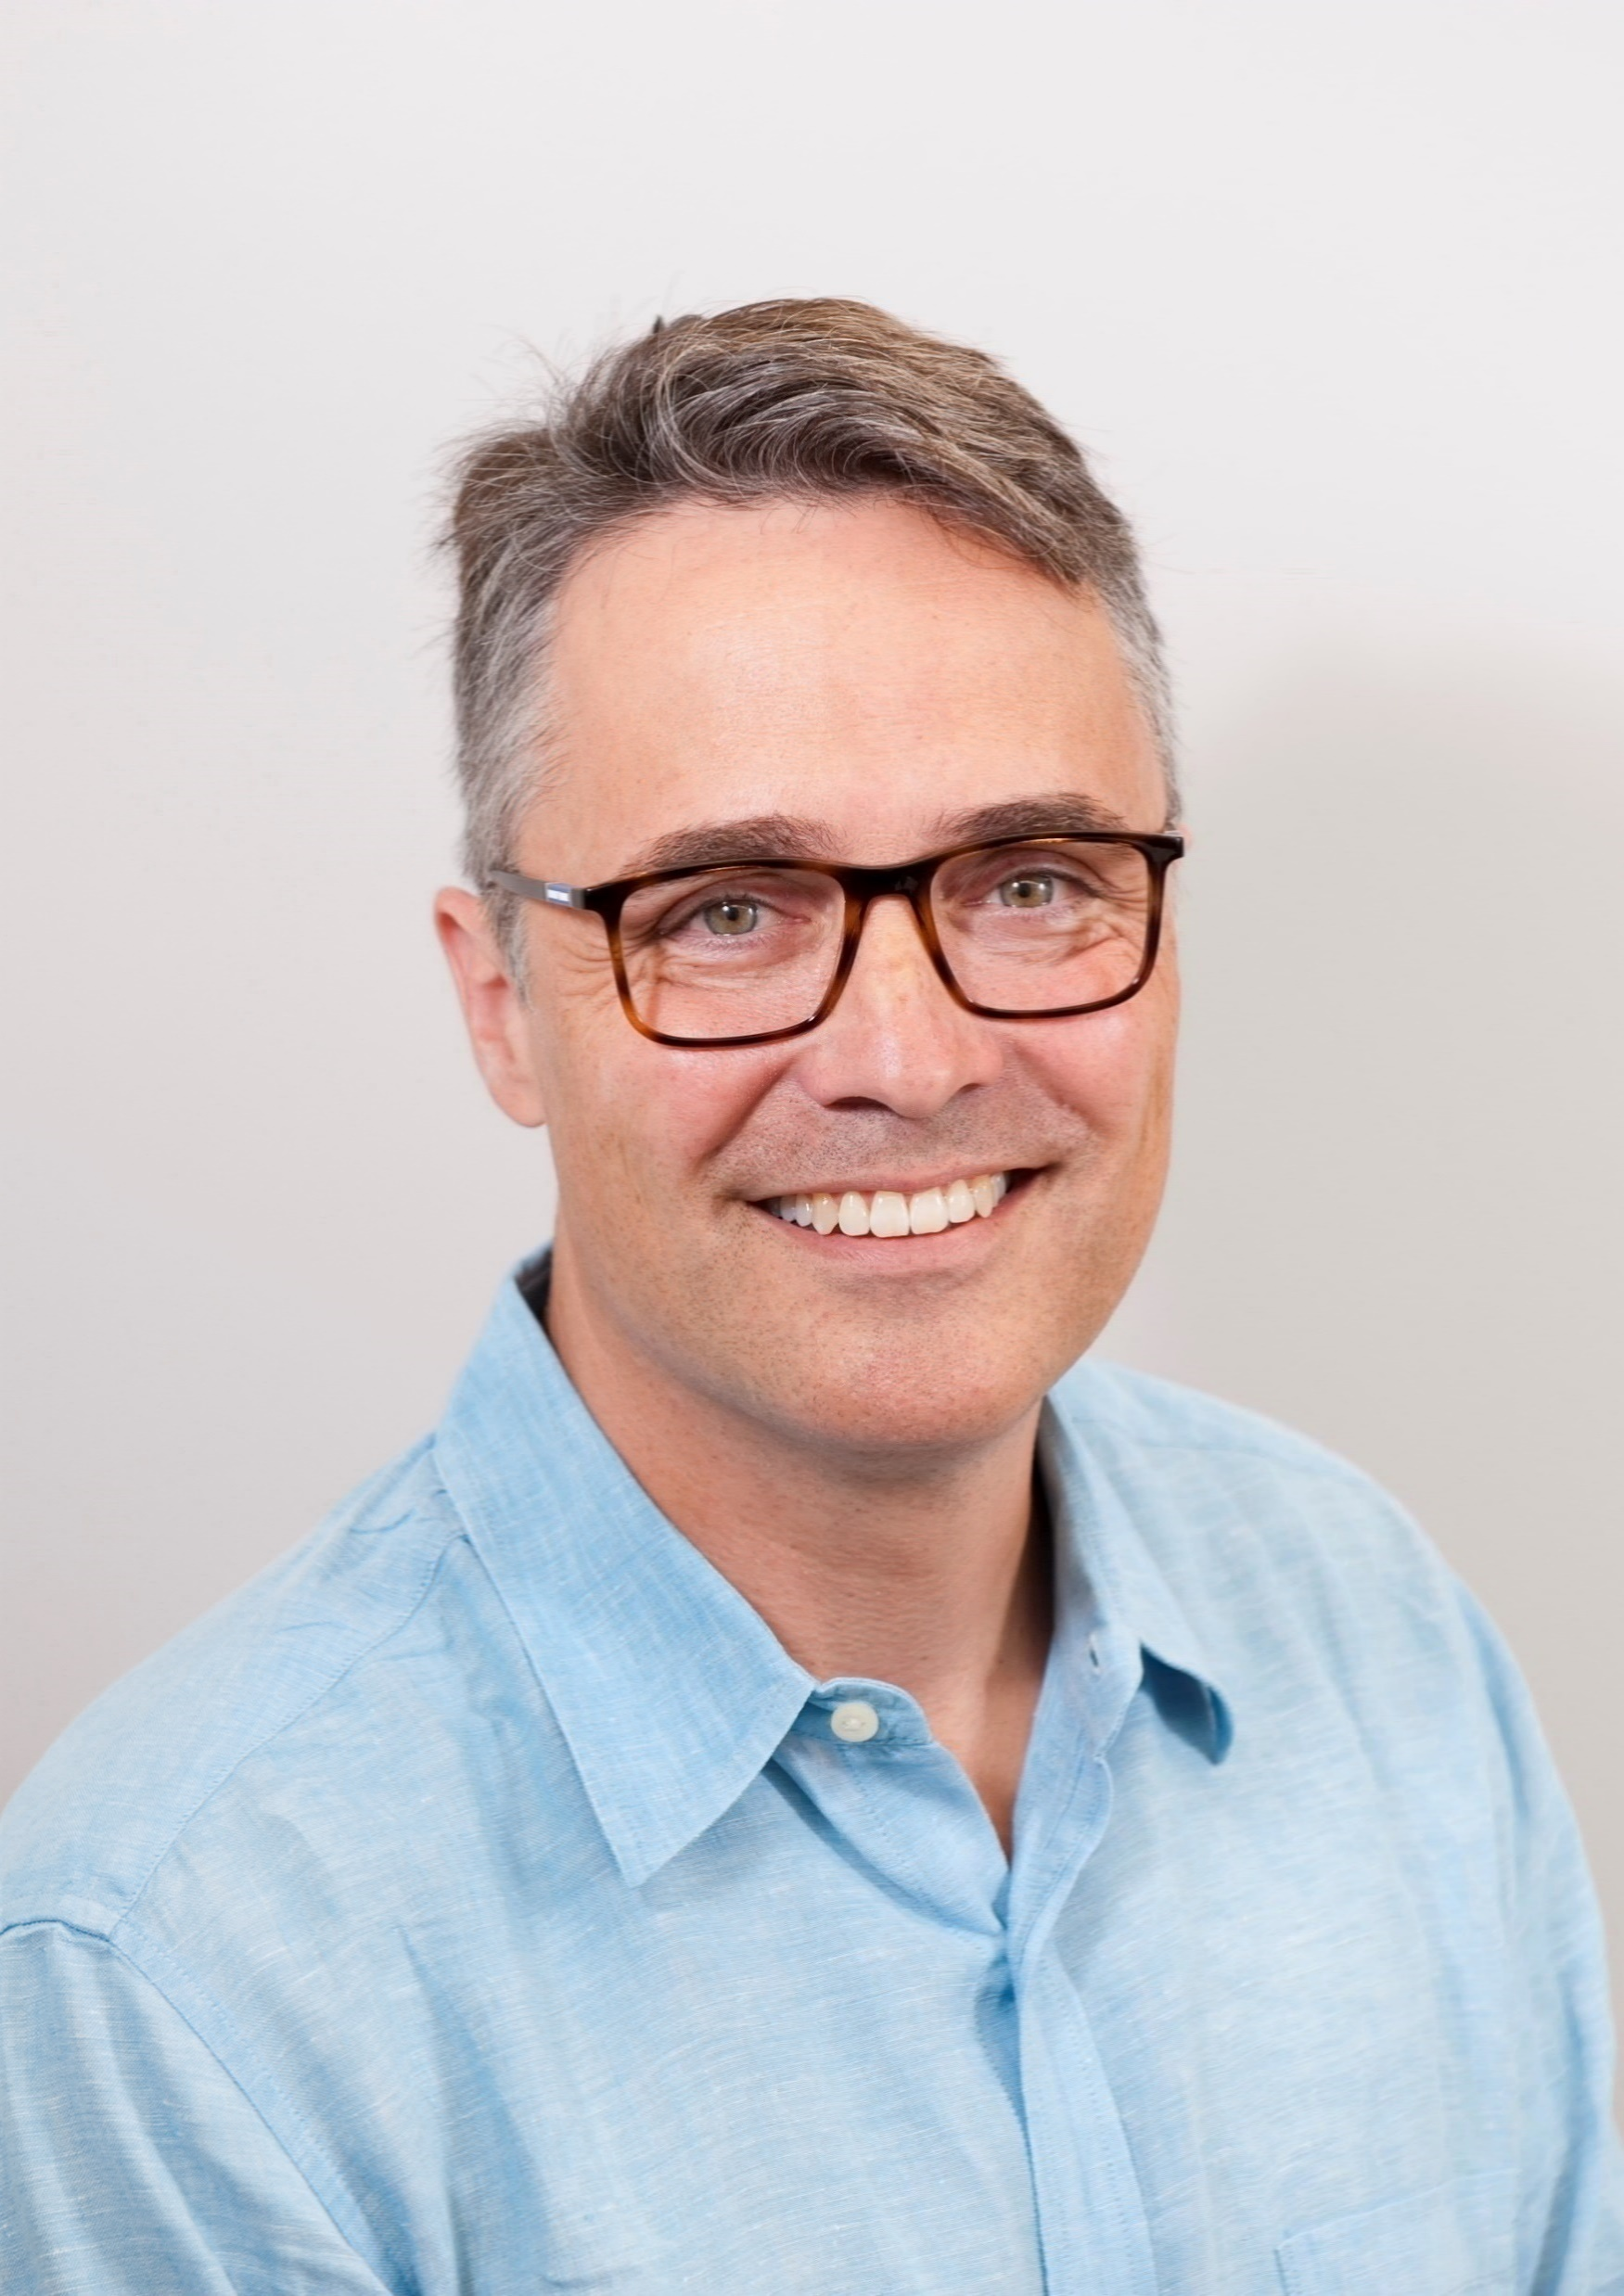
Thank you!
Jason Harlow
Downtown Campus
Let’s talk more!
https://harlow.physics.utoronto.ca/
Jason.harlow@utoronto.ca

